Slide 1
Software Interrupts
Lecture 18
Textbook – Chapter 8

Slide 2
Lecture Content
What is an Interrupt?
How Processor gets Interrupt?
How Processor responds to interrupt?
Hooking an Interrupt

Slide 3
1- What is an Interrupt?

Slide 4
Example - A Sample Process and Interrupt
How long the processer will execute this process?
What if user enters a combination of keys
Alt+Tab
Ctrl+Alt+Del
Others e.g. Esc, Ctrl+C, Ctrl+V etc.
What will be the response of processor on these different combinations?
After the response finishes what will processor execute next?

Slide 5
Example - A Sample Process and Interrupt (Contd.)
How long the processer will execute this process?
What if user enters a combination of keys
Alt+Tab
Ctrl+Alt+Del
Others e.g. Esc, Ctrl+C, Ctrl+V etc.
What will be the response of processor on these different combinations?
After the response finishes what will processor execute next?
Examples: Keyboard, Mouse, USB Interrupts and handlers etc.
Interrupt
Interrupt
Handler

Slide 6
Interrupt:
“An interrupt is an input signal to the processor indicating an event that needs immediate attention.”
Interrupts are Events that occur outside the processor and the processor must be informed about them

Slide 7
Interrupt Handler
00000
….
KeyboardISR: …
…
….
MouseISR: …
…
….
USBISR: …
…
“The Routine that executes in response to an INT instruction is called the Interrupt Service Routine (ISR) or Interrupt Handler”
ISR is just a piece of code (list of instructions) or program residing somewhere in memory.
For example, KeyboardISR, is handling all the keys and showing you different screens/functionalities for different combinations i.e Ctrl+Alt+Del, WindowsKey+D, Esc, Ctrl+C, Ctrl+V etc.
0ABCD
0BCDE
0CDEF
FFFFF

Slide 8
2- How Processor gets the Interrupt?

Slide 9
How Interrupt occurs?
Interrupt may be triggered by:
1- Device external to CPU, for example, moving mouse or pressing a key on keyboard, inserting a USB
2- Software Interrupt Instructions i.e. just like other assembly instructions, INT instruction generates interrupt. For example,
;Some Assembly code here
MOV AX, BX
INT 0x16 ; Call BIOS keyboard service
;Some Assembly code here
INT 0x10 ; call BIOS Video Service
3- under certain conditions, by the CPU itself, for example, divide by zero generates INT 0

Slide 10
3- How Processor responds to Interrupt?

Slide 11
List of Interrupts

Slide 12
List of Interrupts (8088 Processor)
No. | Description
00 | DIVIDE ERROR
01 | SINGLE STEP
02 | NON-MASKABLE INTERRUPT
03 | BREAKPOINT
04 | INTO DETECTED OVERFLOW
 | …
08 | SYSTEM TIMER
09 | KEYBOARD DATA READY
… | …
10 | BIOS Video Service
…
16 | BIOS Keyboard Service
… | …
21 | Terminate Program
… | …
FF | …

Slide 13
Interrupt Handler
If CS=19F5 and IP=02E7, what will be the physical address of this instruction?
19F50
+ 002E7
= 1A237
----------------------------------------------------------------------------------------
What should be the value of CS and IP for USBISR?
CS = BCDE and IP = 000F
BCDE0
+ 0000F
= BCDEF
Homework: What values we need in CS and IP to execute KeyboardISR and MouseISR?
00000
….
KeyboardISR: …
…
….
MouseISR: …
…
….
USBISR: …
…
0ABCD
ABCDE
BCDEF
FFFFF

Slide 14
Saving Address of an ISR
INT 255 | Segment255 (CS) | Offset255 (IP)
… | … | …
INT N | SegmentN | OffsetN
… | … | …
INT 9 | Segment9 ABCD | Offset9 000E
… | … | …
INT 3 | Segment3 | Offset3
INT 2 | Segment2 | Offset2
INT 1 | Segment1 | Offset1
INT 0 | Segment0 | Offset0
00000
….
KeyboardISR: …
…
ABCD0
+ 0000E
= ABCDE
ABCDE
Segment9:Offset9
gives us physical
Address of KeyboardISR
FFFFF
If we set our CS register to SegmentN and IP to OffsetN then which instruction will be executed next?

Slide 15
Saving Address of an ISR
… | … | …
00003 | Segment0 | INT 0, Division by Zero
00002
00001 | Offset0
00000
Physical Memory Address | Memory Content | INT
We need 2 bytes to save IP and 2 bytes for CS
Interrupt Vector Table

Slide 16
Saving Address of an ISR
… | … | …
00007 | Segment1 | INT 1, Single Step Interrupt
00006
00005 | Offset1
00004
00003 | Segment0 | INT 0, Division by Zero
00002
00001 | Offset0
00000
Physical Memory Address | Memory Content | INT
Interrupt Vector Table

Slide 17
Saving Address of an ISR
… | … | …
00011 | Segment2 | INT 2, NMI
00010
00009 | Offset2
00008
00007 | Segment1 | INT 1, Single Step Interrupt
00006
00005 | Offset1
00004
00003 | Segment0 | INT 0, Division by Zero
00002
00001 | Offset0
00000
Physical Memory Address | Memory Content | INT
Interrupt Vector Table

Slide 18
Saving Address of an ISR
… | … | …
00011 | Segment2 | INT 2, NMI
00010
00009 | Offset2
00008
00007 | Segment1 | INT 1, Single Step Interrupt
00006
00005 | Offset1
00004
00003 | Segment0 | INT 0, Division by Zero
00002
00001 | Offset0
00000
Physical Memory Address | Memory Content | INT
What will be the physical address of Offset and Segment of INT N?
OffsetN (IP) will be at Nx4
SegmentN (CS) will be at (Nx4) + 2
What will be the physical address of Offset and Segment of INT 255? Do yourself
This table is called Interrupt Vector Table.
How much total space IVT needs in memory?
256x4 = 1020 Bytes = 1KB
One entry in this table is called a vector.
Interrupt Vector Table

Slide 19
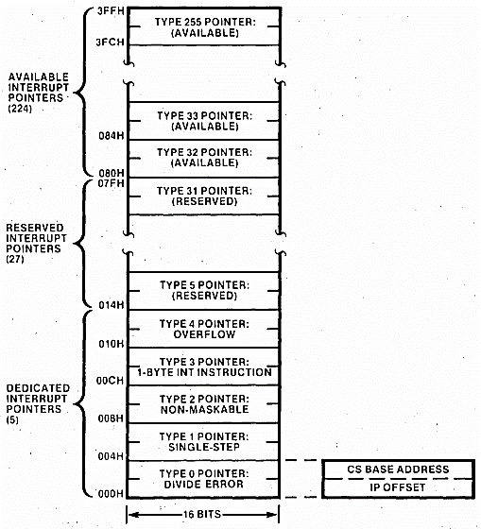
Interrupt Vector Table(IVT)
KeyboardIRS:
…
…
Reading Assignment - Textbook Chapter 8, Topic 8.1
5 Dedicated Interrupts – programmed in the hardware to generate the designated interrupt when the specified condition arises
27 Reserved Interrupts – reserved by the IBM PC designers to interface user programs with system software like DOS and BIOS
224 Available Interrupts – for use in user software
Type 9 Pointer
Notes:
Image Reference: 8088 Manual Page 2-9

Slide 20
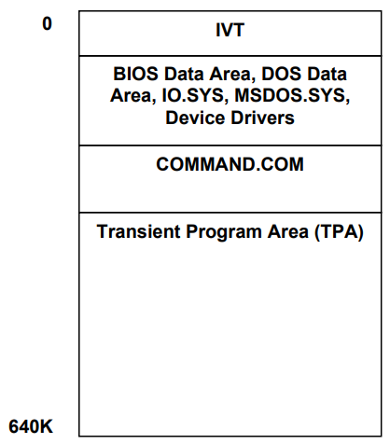
Memory Configuration
00000
x003FF
1- IVT resides in first 1K bytes of the physical memory i.e. from
Physical address 0x00000 to 0x003FF.
2- System Files (Reserved Area)
3 - Programs are loaded and executed in TPA
FFFFF

Slide 21
Operations of Processor after getting Interrupt N
Complete current Instruction
sp ← sp-2
[sp] ← flag (Save Current State)
if ← 0
tf ← 0
sp ← sp-2
[sp] ← cs
sp ← sp-2
[sp] ← ip
ip ← [0:N*4] (for Nth Interrupt)
cs ← [0:N*4+2]
…
Offset of Next Instruction
CS
FLAGS
CS:IP for Next Instruction
To be executed on return
Stack
Which instruction will be executed next?
As soon as these values are loaded in CS and IP execution goes to the start of the interrupt handler or ISR of Nth interrupt.

Slide 22

Interrupt and Trap Flags
Trap Flag (T) - The trap flag has a special role in debugging
Interrupt Flag (I) - It tells whether the processor can be interrupted from outside or not.

Slide 23
After Execution of ISR
…
Offset of Next Instruction
CS
FLAGS
When the handler finishes its work it uses the IRET instruction to return to the caller.
ip ← [sp]
sp ← sp+2
cs ← [sp]
sp ← sp+2
flag ← [sp]
sp ← sp+2
Stack
ISRN: …
;Assembly Code Here
…
…
IRET ; Return from ISR
Sample ISR

Slide 24
5- Example 8.1 Hooking Divide by Zero Interrupt

Slide 25
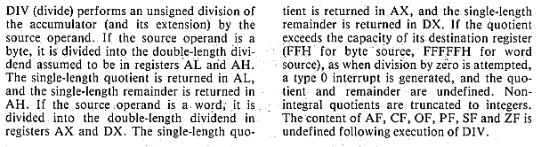
DIV Instruction and Division by Zero Interrupt

Slide 26
Reading Assignment
Topic 8.1 includes Interrupts reserved by Processor

